Slide 1

Team: System Tron
CSE_303(Database Management System)
Section: 01
Course Instructor:
Dr. Nafees Mansoor, PhD
Assistant Professor, Dept. of CSE, ULAB
Notes:
Photo by Charles Forerunneron Unsplash

Slide 2

Main Idea Of Project
A database for the fruit seller.
Seller can store and maintain the related business data.
Notes:
Photo by Floriane Vitaon Unsplash

Slide 3
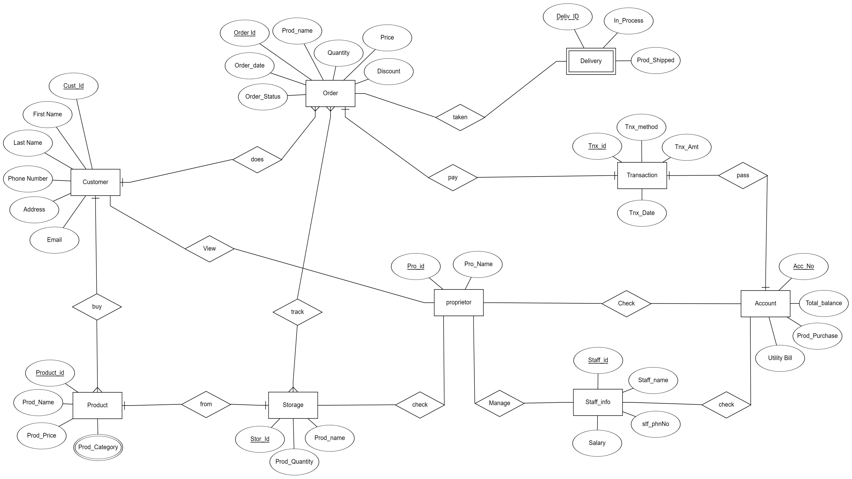
ER Diagram:
Notes:
Photo by J. Kelly Britoon Unsplash

Slide 4

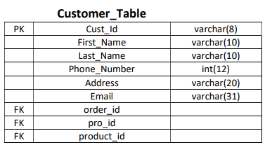
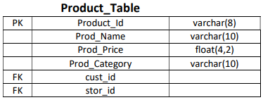
Data Type & Size
Notes:
Photo by Campaign Creatorson Unsplash

Slide 5
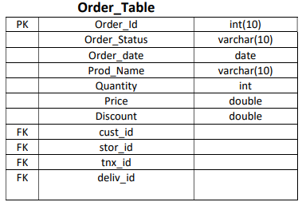
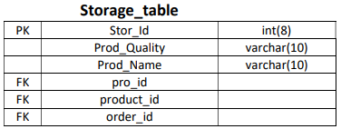
Data Type & Size
Notes:
Photo by Campaign Creatorson Unsplash

Slide 6
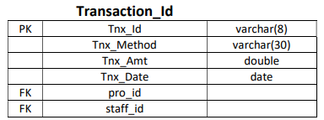
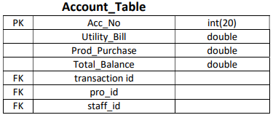
Data Type & Size
Notes:
Photo by Campaign Creatorson Unsplash

Slide 7
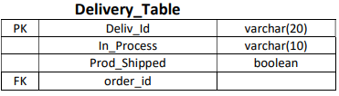
Data Type & Size
Notes:
Photo by Campaign Creatorson Unsplash

Slide 8
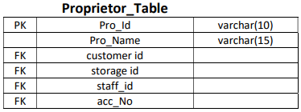
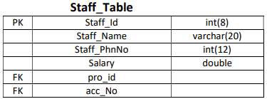
Data Type & Size
Notes:
Photo by Campaign Creatorson Unsplash

Slide 9
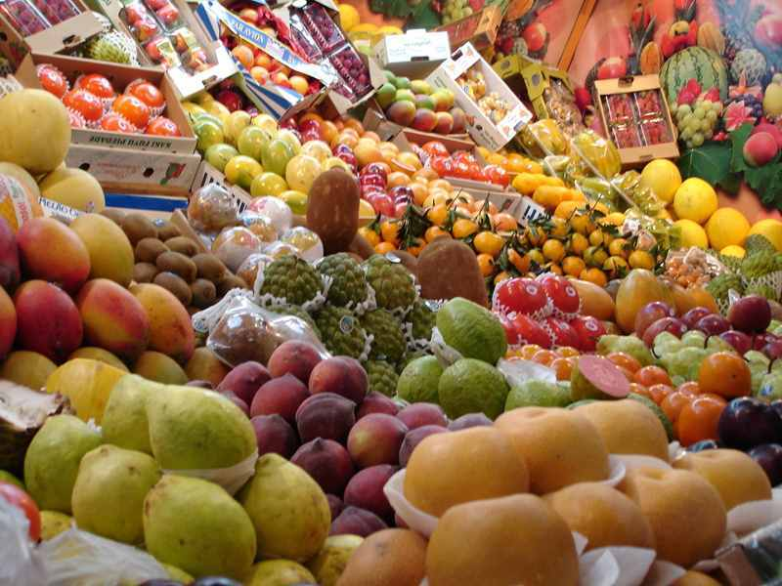
Thank You
Notes:
Photo by fauxels from Pexels

